Slide 1

Atal Bihari Vajpayee-
Indian Institute of Information Technology and Management Gwalior
Computer Graphics Lab : 09
Scene Creation in 3D
Instructor – Dr. Sunil Kumar
Assistant Professor @ Dept. of Information Technology, ABV-IIITM Gwalior
Teaching Assistants (TAs)
Mehr Aliah, Radhika Gupta, Pranav | Group-02
Anushka Agarwal, Abhishek Shrivastav, Aditya, Sheel Patel | Group-01

Slide 2
Objective of this lab
The objective of this experiment is to understand the process of 3D scene creation using the World Coordinate System (WCS). It aims to create and visualize a 3D unit cube and study the effects of various geometric transformations, including translation, scaling, rotation, shearing, and reflection, on three-dimensional objects.

Slide 3
Demo Assignment - 01
int main(int argc, char **argv)
{
glutInit(&argc, argv);
glutInitDisplayMode(
GLUT_DOUBLE | GLUT_RGB | GLUT_DEPTH
);
glutInitWindowSize(500, 500);
glutCreateWindow("3D Shaded Sphere");
init();
glutDisplayFunc(display);
glutMainLoop();
return 0;
}
#include <GL/freeglut.h>
void display()
{
glClear(GL_COLOR_BUFFER_BIT | GL_DEPTH_BUFFER_BIT);
glMatrixMode(GL_MODELVIEW);
glLoadIdentity();
gluLookAt(0, 0, 5,
0, 0, 0,
0, 1, 0);
// Light position
GLfloat lightPos[] = { -3, 4, 5, 1 };
glLightfv(GL_LIGHT0, GL_POSITION, lightPos);
// Sphere color
glColor3f(0.1, 0.3, 1.0);
// Draw 3D sphere
glutSolidSphere(1.5, 40, 40);
glutSwapBuffers();
}
void init()
{
glClearColor(1, 1, 1, 1);
glEnable(GL_DEPTH_TEST);
// Enable lighting
glEnable(GL_LIGHTING);
glEnable(GL_LIGHT0);
glEnable(GL_COLOR_MATERIAL);
glColorMaterial(GL_FRONT, GL_AMBIENT_AND_DIFFUSE);
glEnable(GL_NORMALIZE);
GLfloat ambient[] = { 0.25, 0.25, 0.25, 1 };
GLfloat diffuse[] = { 1, 1, 1, 1 };
glLightfv(GL_LIGHT0, GL_AMBIENT, ambient);
glLightfv(GL_LIGHT0, GL_DIFFUSE, diffuse);
// Set perspective view
glMatrixMode(GL_PROJECTION);
glLoadIdentity();
gluPerspective(45, 1, 1, 100);
glMatrixMode(GL_MODELVIEW);
}

Slide 4
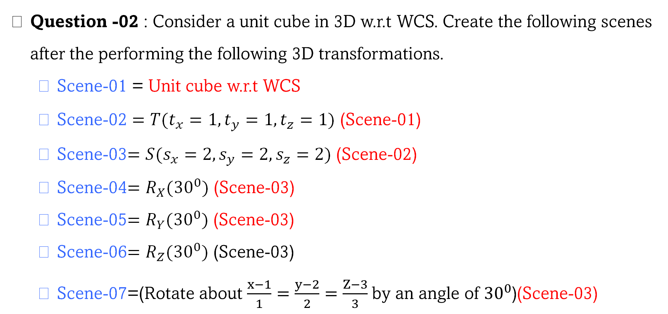
Assignment - 02
Question -02 : Consider a unit cube in 3D w.r.t WCS. Create the following scenes after the performing the following 3D transformations.
  Scene-01 = Unit cube w.r.t WCS
  Scene-02 $=T(t_{x}=1,t_{y}=1,t_{z}=1)$ (Scene-01)
  Scene-03$=S(s_{x}=2,s_{y}=2,s_{z}=2)$ (Scene-02)
  Scene-04$=R_{X}({30}^{0})$ (Scene-03)
  Scene-05$=R_{Y}({30}^{0})$ (Scene-03)
  Scene-06$=R_{Z}({30}^{0})$ (Scene-03)
  Scene-07=(Rotate about $\frac{x−1}{1}=\frac{y−2}{2}=\frac{Z−3}{3}$ by an angle of ${30}^{0}$)(Scene-03)

Slide 5
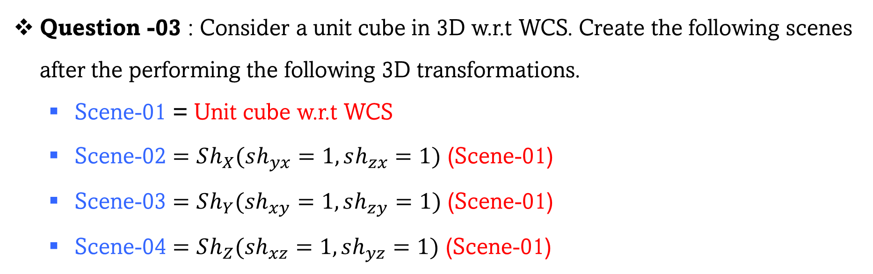
Assignment - 03
Question -03 : Consider a unit cube in 3D w.r.t WCS. Create the following scenes after the performing the following 3D transformations.
  Scene-01 = Unit cube w.r.t WCS
  Scene-02 $=Sh_{X}(sh_{yx}=1,sh_{zx}=1)$ (Scene-01)
  Scene-03 $=Sh_{Y}(sh_{xy}=1,sh_{zy}=1)$ (Scene-01)
  Scene-04 $=Sh_{Z}(sh_{xz}=1,sh_{yz}=1)$ (Scene-01)

Slide 6
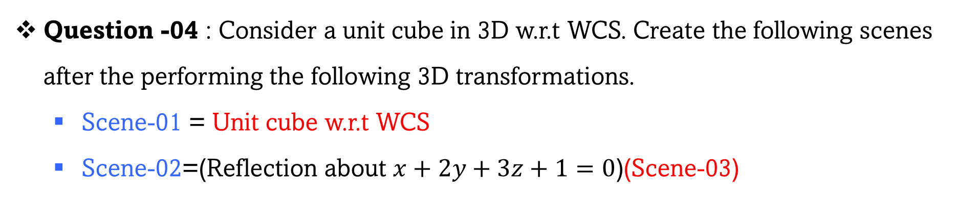
Assignment - 04
Question -04 : Consider a unit cube in 3D w.r.t WCS. Create the following scenes after the performing the following 3D transformations.
  Scene-01 = Unit cube w.r.t WCS
  Scene-02=(Reflection about $x+2y+3z+1=0$)(Scene-03)

Slide 7
Assignment - 05
Question -05 : Create a scene of your interest
YOUR SCENE

Slide 8
Thank you !

